Slide 1
Globe Machine Manufacturing Company Presentation to: University of Washington, Tacoma
701 East D Street Tacoma, Washington, USA Ph 253-383-2584 Fax 253-572-9672 www.globemachine.com
Notes:
Welcome Faculty, Students, UWT Global Honors Program.
Thank you for the invitation to provide remarks to the Colloquium. Debra Friedman would be pleased that this challenging interdisciplinary program that strengthens students’ knowledge and experience in a global context is strong and continuing to grow
I am a local guy, born and raised in Tacoma, managing an engineering and manufacturing business on the Thea Foss Waterway. I am also interested, through our Family Foundation, founded in 1990 and directed by my daughter Holly Bamford Hunt, in community building beginning at the local level. Global Engagement and Citizenship is a core value to our Family.
The following slides will provide a short introduction to my experience.

Slide 2
Company and Facilities
Globe founded in 1917 in Tacoma, Washington, USA
Lightweight Labs founded in 2010
200,000 square feet
Engineering offices
Manufacturing facilities
R&D lab
170+ employees, including over 25 engineers
First-class products known world-wide
Demonstrated domestic and international professionalism in both product offerings and business approaches
Notes:
A family business, Globe Machine Manufacturing Company is approaching 100 years of service to industry. Engineering and Manufacturing of production machinery for large scale facilities is our core activity. We are a fully vertically integrated manufacturer with expertise in high capacity automated production systems, beginning in our history with production machinery for building materials, such as wood composites, oriented strand board, medium density fiberboard, particleboard, moulded doorskins, and plywood industries. Capacities of these large facilities are in excess of 1 Billion Square Feet per year. Our experience in the last 30 years includes manufacturing systems for Paper, wood/plastic composites, compression moulding of UHMW and other sheet plastics, and systems for the production of light weight armor. Recent developments also include introduction of disruptive technology for processing Carbon Fiber for Automotive and Aerospace components. Some examples of our capabilities are described in the following slides.

Slide 3
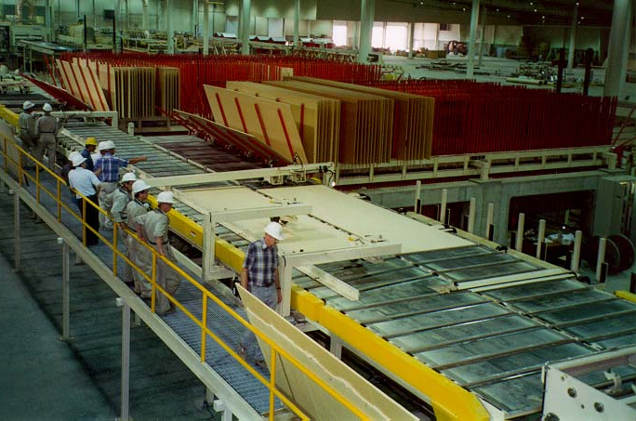
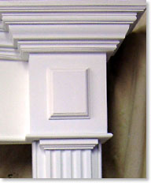
Globe Finishing Lines for MDF and Particleboard
Notes:
The Globe finishing line shown, is processing continuously 10’ wide medium density fiberboard panels at speeds up to 60 meters per minute.

Slide 4
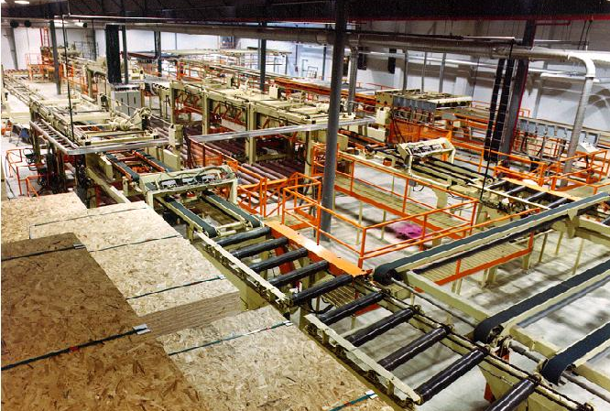
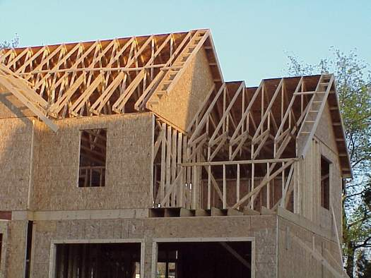
Globe Finishing Lines for OSB
Notes:
This Globe system is a completely automated line for processing oriented strand-board, operating in a facility producing 600 million square feet per year of OSB building material.

Slide 5
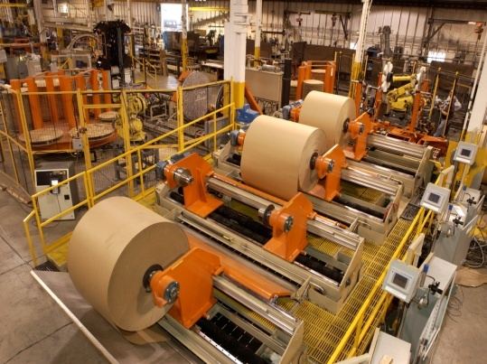
Globe Robotic Roll Finishing Systems
Notes:
We are also active in the engineering and supply of paper roll handling systems, including robotic work cells.

Slide 6
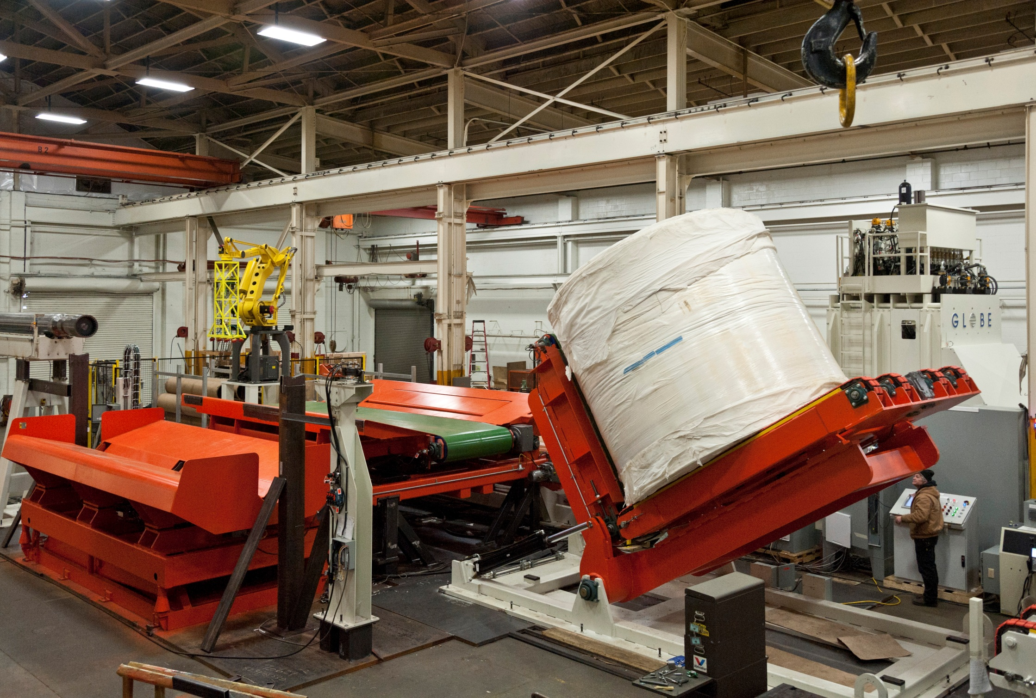
Globe Tissue Paper Handling Systems
Notes:
This is a Tissue Industry roll handling system with integrated robotic work-cell, under test in our Facility in Tacoma.

Slide 7
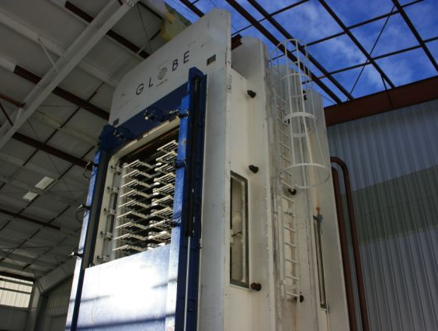
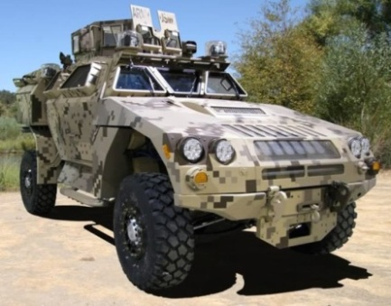
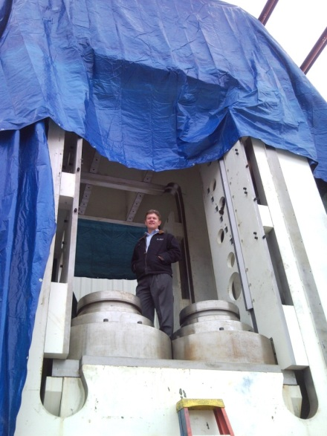
Globe Ultra High Pressure Presses for Light-weight Composite Armor
Light- weight composite armor
Up to 5,000 psi (12,000 ton)
5’ x 10’ and other custom sizes
Full enclosed vacuum press
Multi-daylight (10 opening shown)
Heated and cooled platens
Press Rams at Assembly
Notes:
This slide is a Globe ultra high pressure press for manufacturing light-weight armor. Unit pressures of 5,000 psi, or 12,000 tons maximum are achieved. The system was provided with a completely automated simultaneous loading and unloading system. The 2 Million pound system was designed and manufactured in Tacoma and delivered to the East Coast.

Slide 8
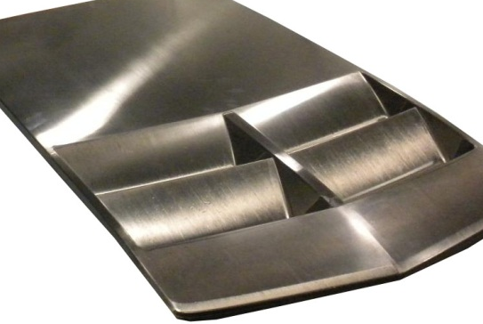
Class A Carbon Fiber Body Panels Complex Demonstration Part
The Rapid Cure System today is production capable and proven to produce superior class A finishes for body panels, such as fenders, roofs and hoods
Notes:
The Globe RapidClave System is a non-autoclave carbon fiber component thermal processing and consolidation system, developed in partnership with Israeli Kibbutz owned Plasan Carbon Composites, that has reduced part to part cycle time from 90 plus minutes to 17 minutes and better. The first application of the rapid cure system today is production proven to produce superior class A finishes for body panels, such as fenders, roofs and hoods. An example of a part produced by the rapid cure system is shown on the slide. A disruptive technology was needed and developed. We agreed that existing processing techniques were limiting the widespread commercialization of advanced materials in the auto industry and other sectors.

Slide 9
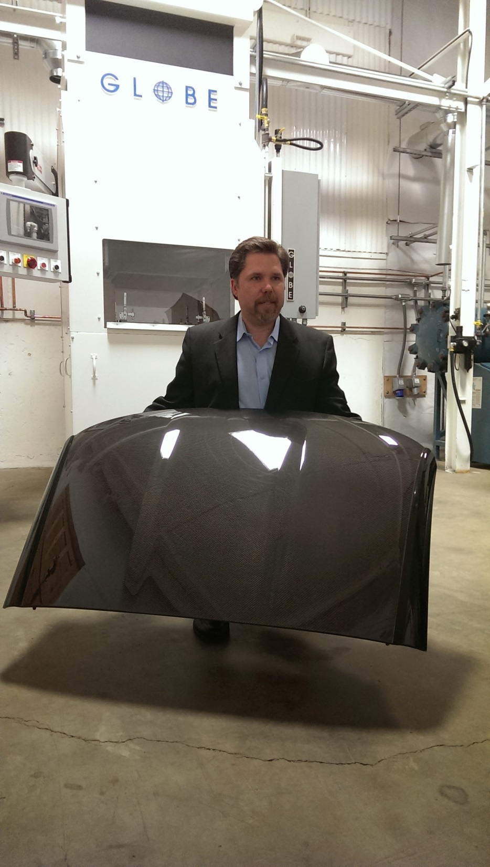
2014 Corvette Stingray Carbon Fiber Roof
Notes:
The 2014 Corvette Stingray roof, produced on the Globe RapidClave, with our VP and General Manager, Ron Jacobsen in our Tacoma Laboratory.

Slide 10
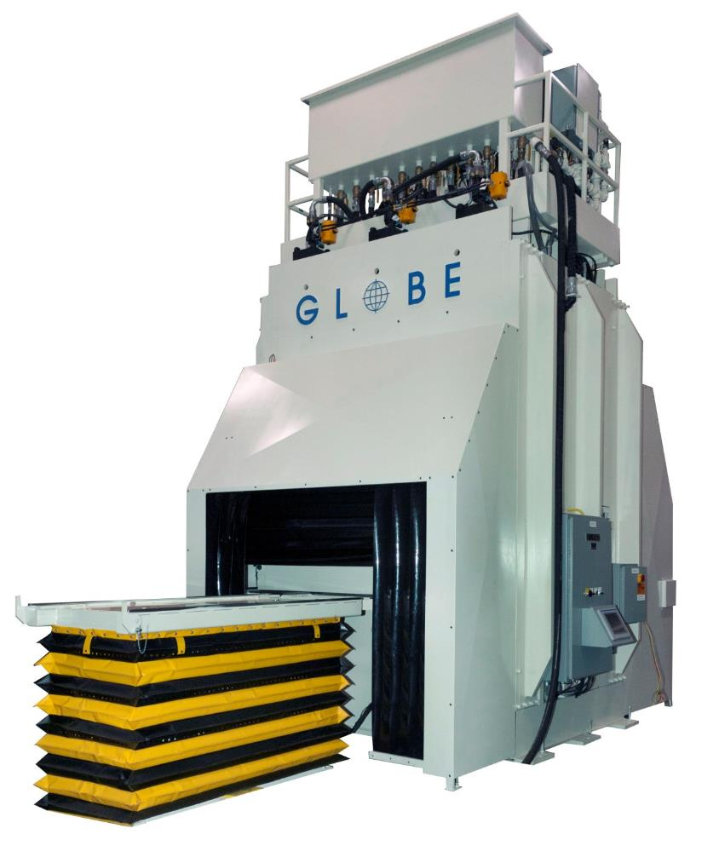
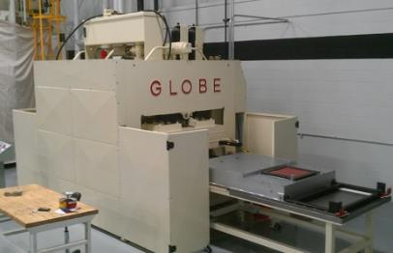
Globe RapidClave™ System for Composite Parts (Patents Pending)
High Pressure Rapid Curing Systems for Out-of-Autoclave Composites Manufacturing
0 – 350 psi pressure
Integrated rapid heating, cooling, vacuum, and automated tool and materials handling
17 minute and less part-to-part cycle time on unidirectional carbon fiber thermoset epoxy prepreg
Notes:
The Globe RapidClave is producing in Michigan 150 sets of Corvette roofs and hoods per day.

Slide 11
An industrial machine manufacturer with expertise in all aspects of process equipment and systems fulfillment, including Design, Engineering, Fabrication, Machining, Assembly, and Sourcing.
An engineering and technology company that develops materials and manufacturing processes for plastic composites including carbon fiber products.
Company & Facilities
+ Globe founded in 1917 in Tacoma, Washington, USA
+ Lightweight Labs founded in 2010
+ 200,000 square feet
+ Engineering offices
+ Manufacturing facilities
+ R&D lab
+ 100+ employees, including 20+ engineers
+ First-class products known world-wide
+ Demonstrated domestic and international professionalism in both product offerings and business approaches
Engineering & Development
+ Product design
+ Systems design
+ Mechanical engineering
+ Electrical engineering
+ Hydraulic & pneumatic engineering
+ Controls engineering
+ PLC and HMI programming
+ Research and development
Manufacturing
+ Fabrication
+ Machining
+ Assembly
+ UL panel shop
+ Industrial robot integration
+ In-house shop testing
+ Global materials sourcing
Systems & Processes
+ Consistent system procedures and management of all jobs of all types and sizes
+ Enterprise resource planning
+ FEA, 2D, 3D modeling
+ Dedicated project management
+ Single point project contact
Clients
Notes:
Globe exports between 60-80% of it’s business internationally. Significant markets are Brazil, Chile, Turkey and Russia. We are engaged in International Business on every continent.

Slide 12
Globe Machine Manufacturing Company University of Washington, Tacoma
701 East D Street Tacoma, Washington, USA Ph 253-383-2584 Fax 253-572-9672 www.globemachine.com
Notes:
1. Global Citizenship and Engagement: My views.
Rene Decarte, philosopher said 400 years ago: It is not enough to have a good mind; the main thing is to use it well, still true today.
Adopt a life-long learning attitude and outlook. Education is a life-long pursuit. Seek out mentors and role models, listen and learn from them.
Study deeply, world history, cultures, geopolitical factors. There are no borders!
On a personal level: Evaluate needs in a field of interest. Seek out where you can add value, make a difference! Create a personal vision and set goals. Adopt! Follow your passion!
Be prepared for continuous course adjustments to reach your objectives. Goals are never attained in a straight line! Critical thinking from a knowledge base is a precondition to make good decisions.
Be opportunistic and adaptive. Create and respond to opportunities, coming from many associations with knowledgeable people.
Participation in your chosen field, will be immensely satisfying if engaged on a Global Basis. The energy and adrenalin rush make the life experience a wonderful and satisfying ride!

